Slide 1
AI-Based House Price Prediction System
Submitted To:
Dinesh Kumar Baghel
Made by:
Aesha Chaudhary(590025445)
Lakshita Negi(590022651)

Slide 2
Buying or selling a house requires estimating the correct price. Manual price estimation is often inaccurate and time-consuming.
Problem Statement
This project develops an AI-based House Price Prediction System that predicts house prices using property features like:
Area
Bedrooms
Bathrooms
Age of House
Location
It helps users know whether a house is within their budget.

Slide 3
Model / Technique / Algorithm Used
Technologies Used
Python
Tkinter (GUI)
Pandas & NumPy
Scikit-learn
Matplotlib
Machine Learning Models Used
Linear Regression
Random Forest Regressor

Slide 4
Working of the System
Steps of Working
Dataset created with house details and prices
Location converted into numeric form using One-Hot Encoding
Data split into Training Set and Testing Set
Two models trained:
Linear Regression
Random Forest
Best model selected using R² Score and RMSE

Slide 5
Algorithm Explanation
Linear Regression
Predicts price using relationship between inputs and output
Best for simple linear data
Random Forest Regressor
Uses multiple decision trees
Gives more accurate predictions
Handles complex data better
Final Selection
Model with highest accuracy is selected automatically.

Slide 6
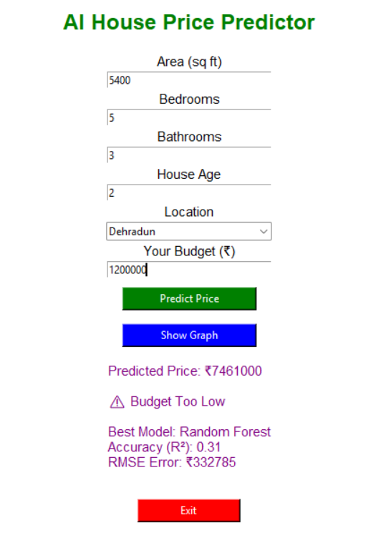
Result
Output Features
User enters:
Area
Bedrooms
Bathrooms
Age
Location
Budget
System shows:
Predicted House Price
Budget Status (Within Budget / Too Low)
Best Model Name
Accuracy Score
Error Value (RMSE)

Slide 7
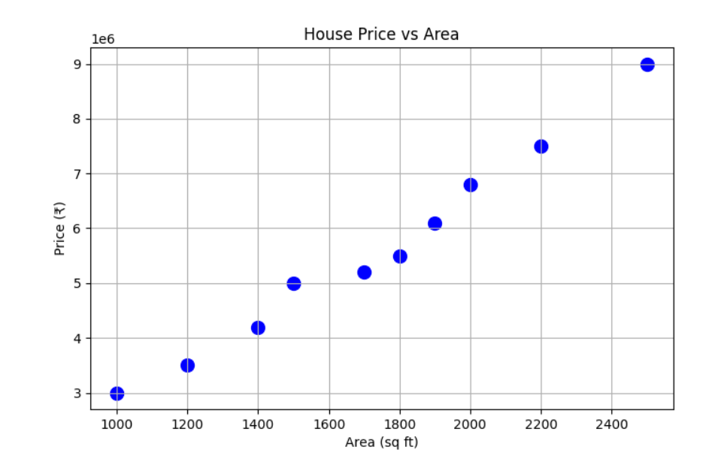
RESULT GRAPH
Graph Generated
House Price vs Area
X-axis → Area
Y-axis → Price
Used scatter plot for visualization.

Slide 8
CONCLUSION
Conclusion
Successfully developed AI House Price Predictor
Compared two ML algorithms
Automatically selected best model
User-friendly GUI interface created
Helps users estimate prices quickly
Future Scope
Use real-world large datasets
Add more cities
Improve accuracy with advanced AI models

